Slide 1
Library Assistant
Voice assistant for library
by:
vatsal shah

Slide 2
Why library voice assistant?
Voice control from any Google assistant compatible devices
Advanced technology for easy remote access
Attractive and optimized solution
Save time and energy
Convenient for differently abled people

Slide 3
How library voice assistant helps?
Easy to find location/ timing of library
Locate books within seconds
Search a book by Author, Title, Publisher, Discipline, Language, etc
Check total number of books issued on your account
Conveniently renew books
Moreover, access all functionalities on the website with voice commands
Infinite possibilities

Slide 4
Flow Chart
Open Western Library Skill
Yes
User request – Check AccessToken
No
Check RefreshToken time and update in DB
Redirect to login page of University
Yes
No
Create New Entry in DB with AccessToken and RefreshToken
Skill not link with user
Welcome Prompt for User
End

Slide 5
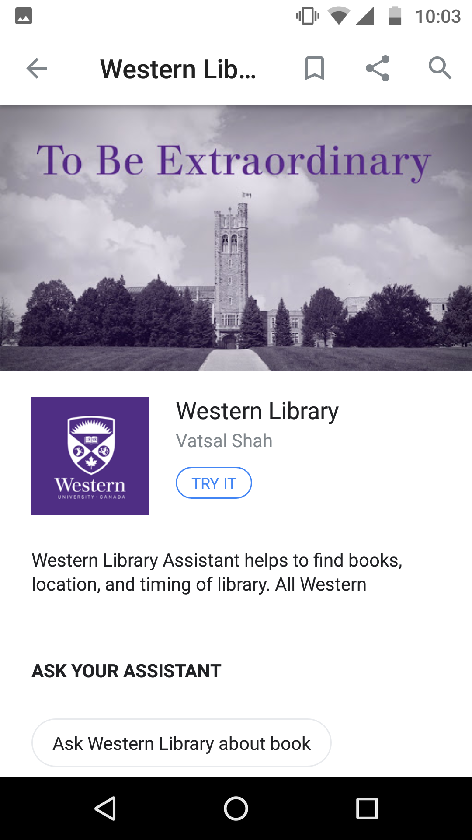
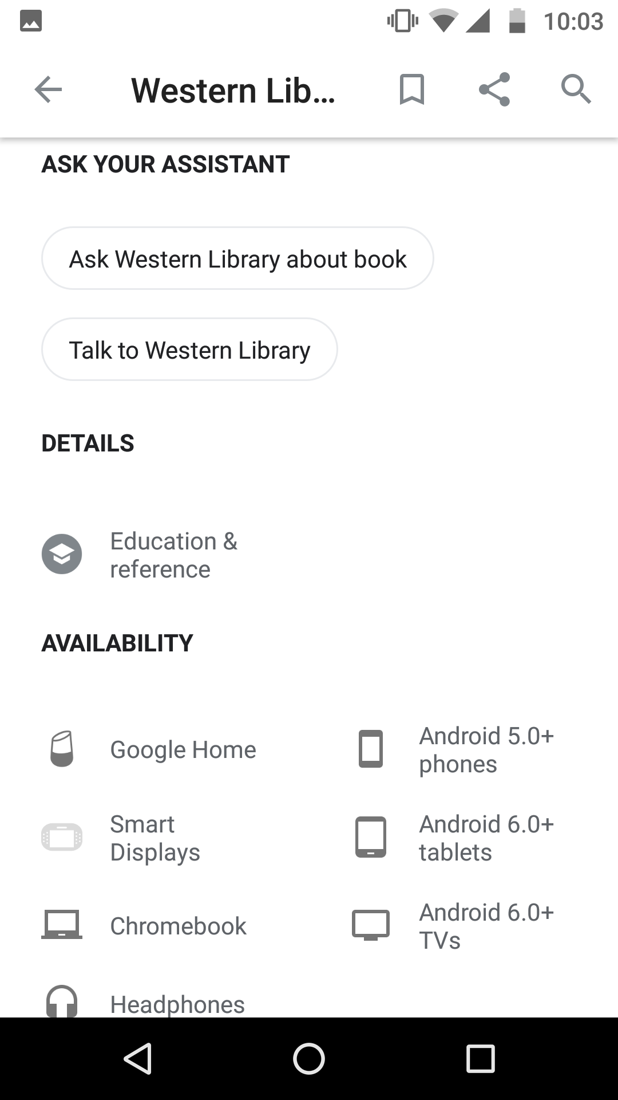
Skill page
Skill page as shows in any devices (Phone, Tablet)
Screenshot captured from my android device

Slide 6
Implementation
Implement OAuth2.0 Server to store Users details, authorization code, access token and expired datetime. (OAuth2.0 is necessary to use with google assistant)
On Server-side node.js and database as Sqlite3
Tables as: users, oauth_authorize, oauth_client, oauth_referesh_token, oauth_token
More info on OAuth2.0: https://oauth.net/2/
Deploy/install my Node server on western server. (Requirement: Linux system)

Slide 7
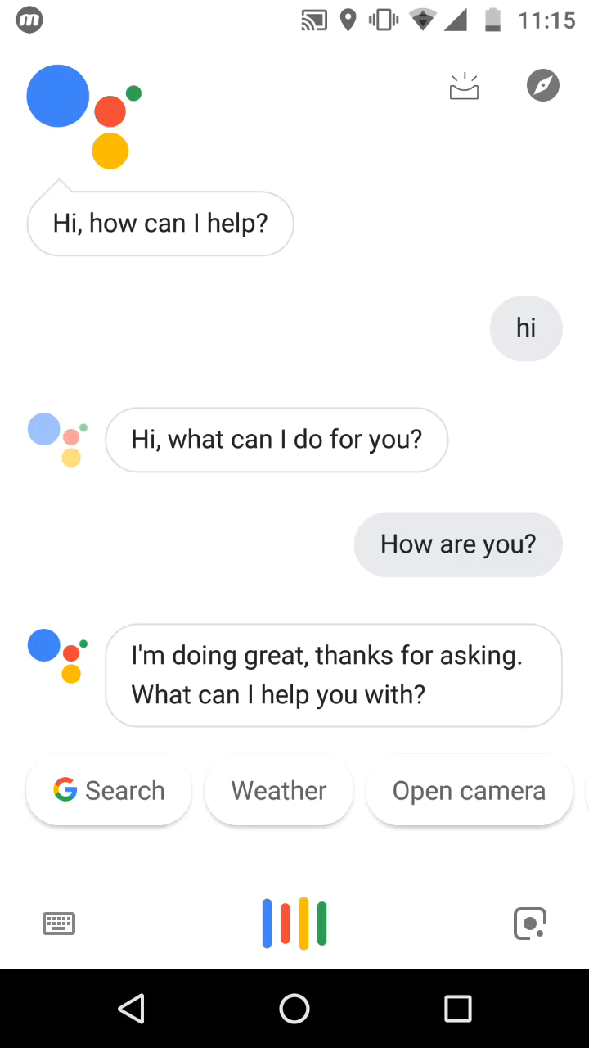
Demo Video
Video is captured from my android device.
(Audio is unavailable)
Sample Phrases:
Find Book
Find “Data Analytics Book”
Is Taylor Library open today?
Which library will be open tomorrow at 5:00 pm?
How many books are issued in my account?
Is there any book available by Author Mr. XYZ.
Find location of Taylor Library.

Slide 8
Requirement from Library
Provide APIs as below:
Authenticate User with western credentials
Details of all library name, timing and location
Search book with title, author, same as on website

Slide 9
Thank you
Contact details:
Website : http://www.vatsalshah.in
Contact No : (647) 467-2210
Email ID : info@vatsalshah.in

